Slide 1
Question Answering
Advanced: Answering Complex Questions

Slide 2
Answering harder questions
Q: What is water spinach?
A: Water spinach (ipomoea aquatica) is a semi-aquatic leafy green plant with long hollow stems and spear- or heart-shaped leaves, widely grown throughout Asia as a leaf vegetable. The leaves and stems are often eaten stir-fried flavored with salt or in soups. Other common names include morning glory vegetable, kangkong (Malay), rau muong (Viet.), ong choi (Cant.), and kong xin cai (Mand.). It is not related to spinach, but is closely related to sweet potato and convolvulus.

Slide 3
Answering harder question
Q: In children with an acute febrile illness, what is the efficacy of single medication therapy with acetaminophen or ibuprofen in reducing fever?
A: Ibuprofen provided greater temperature decrement and longer duration of antipyresis than acetaminophen when the two drugs were administered in approximately equal doses. (PubMedID: 1621668, Evidence Strength: A)

Slide 4
Answering harder questions via query-focused summarization
The (bottom-up) snippet method
Find a set of relevant documents
Extract informative sentences from the documents (using tf-idf, MMR)
Order and modify the sentences into an answer
The (top-down) information extraction method
build specific answerers for different question types:
definition questions,
biography questions,
certain medical questions

Slide 5
The Information Extraction method
a good biography of a person contains:
a person’s birth/death, fame factor, education, nationality and so on
a good definition contains:
genus or hypernym
The Hajj is a type of ritual
a medical answer about a drug’s use contains:
the problem (the medical condition),
the intervention (the drug or procedure), and
the outcome (the result of the study).

Slide 6
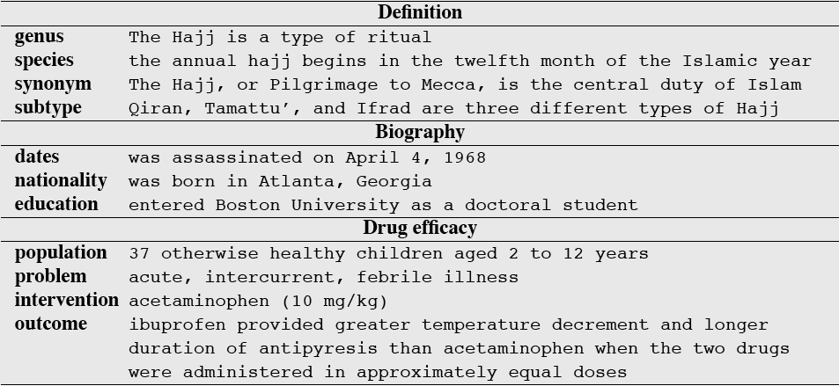
Information that should be in the answer for 3 kinds of questions

Slide 7
Architecture for complex question answering: definition questions
S. Blair-Goldensohn, K. McKeown and A. Schlaikjer. 2004. Answering Definition Questions: A Hyrbid Approach.

Slide 8
Question Answering
Advanced: Answering Complex Questions

